Slide 1

4’s Multiplication Table
Flashcards from: gfletchy.com

Slide 2
Ways to Use:
Look at each flashcard and state how many groups you see and how many are in each group.
Look at each flashcard and state how many groups you see and how many are in each group and how many all together
Look at a flashcard, then quickly move to the next slide, which is blank, and state how many groups you see and how many are in each group. Then, go back and check your work.
Look at a flashcard, then quickly move to the next slide, which is blank, and state how many groups you see, how many are in each group and how many all together. Then go back and check your work.
Look at a flashcard, then quickly move to the next slide, which is blank, and state the multiplication fact and answer that you saw. Then go back and check your work. For example, the first slide is 2x1=2
***use whichever way that is a challenge for you! If one of the above options is too easy, move to the next level ☺ Move to the next multiplication table once you feel you have mastered this one.

Slide 3
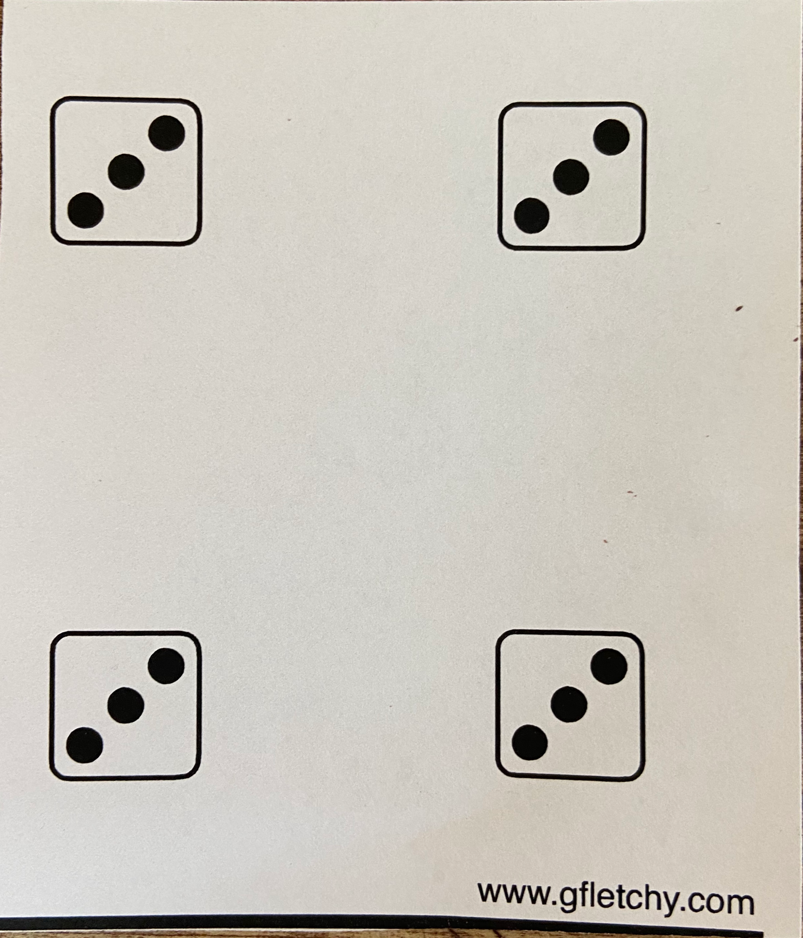

Slide 5
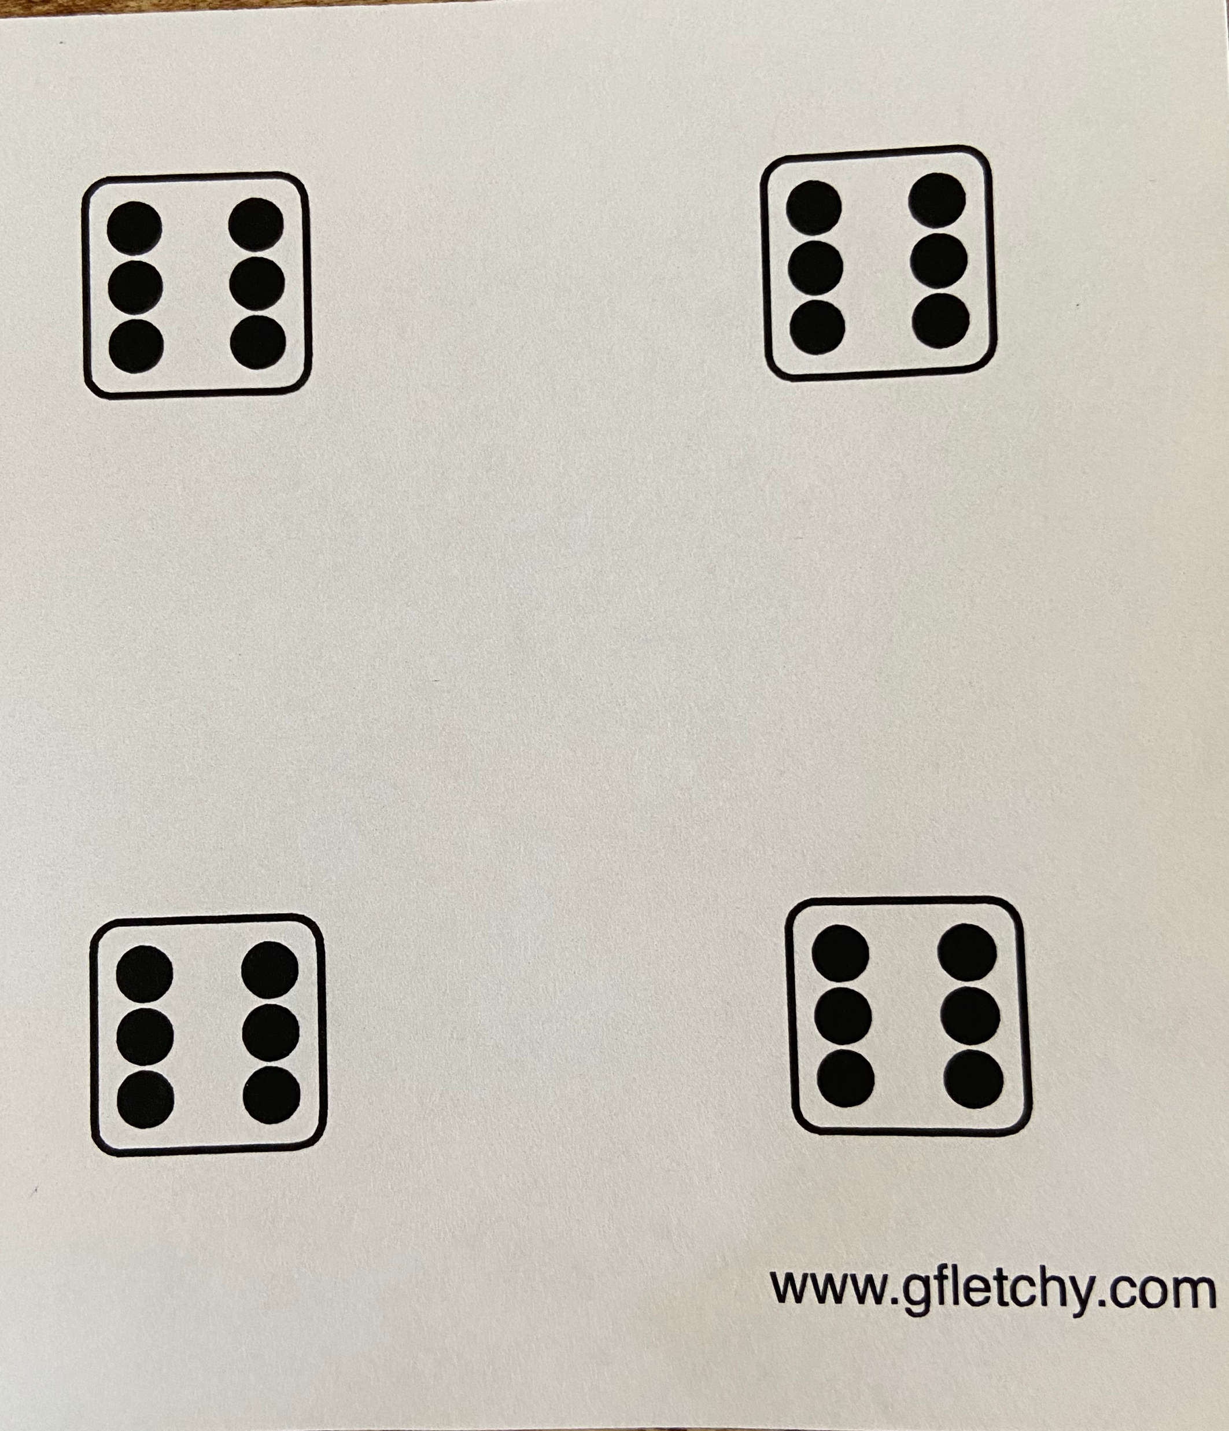

Slide 7


Slide 9
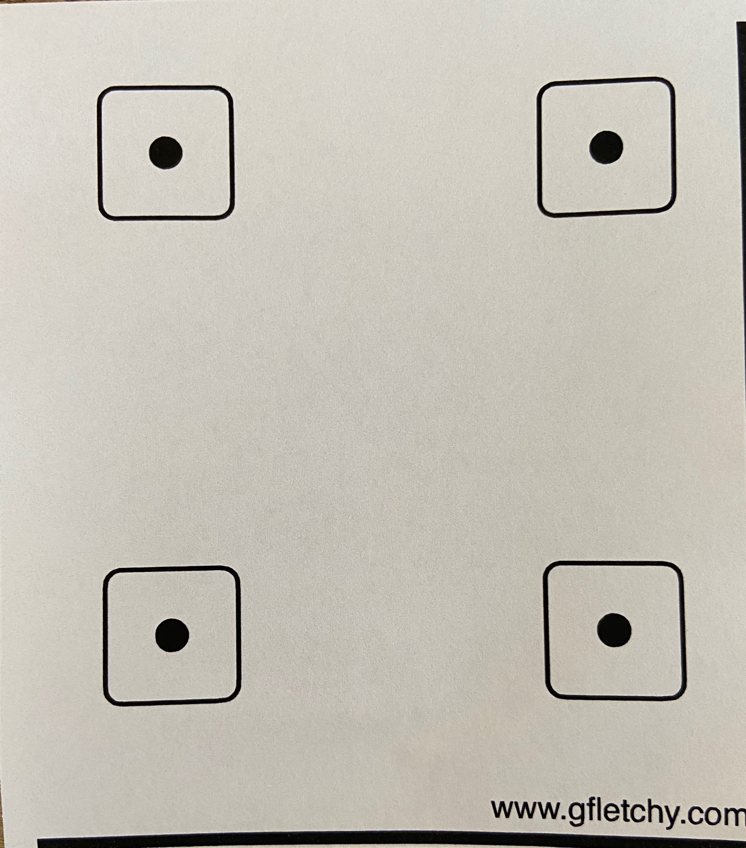

Slide 11
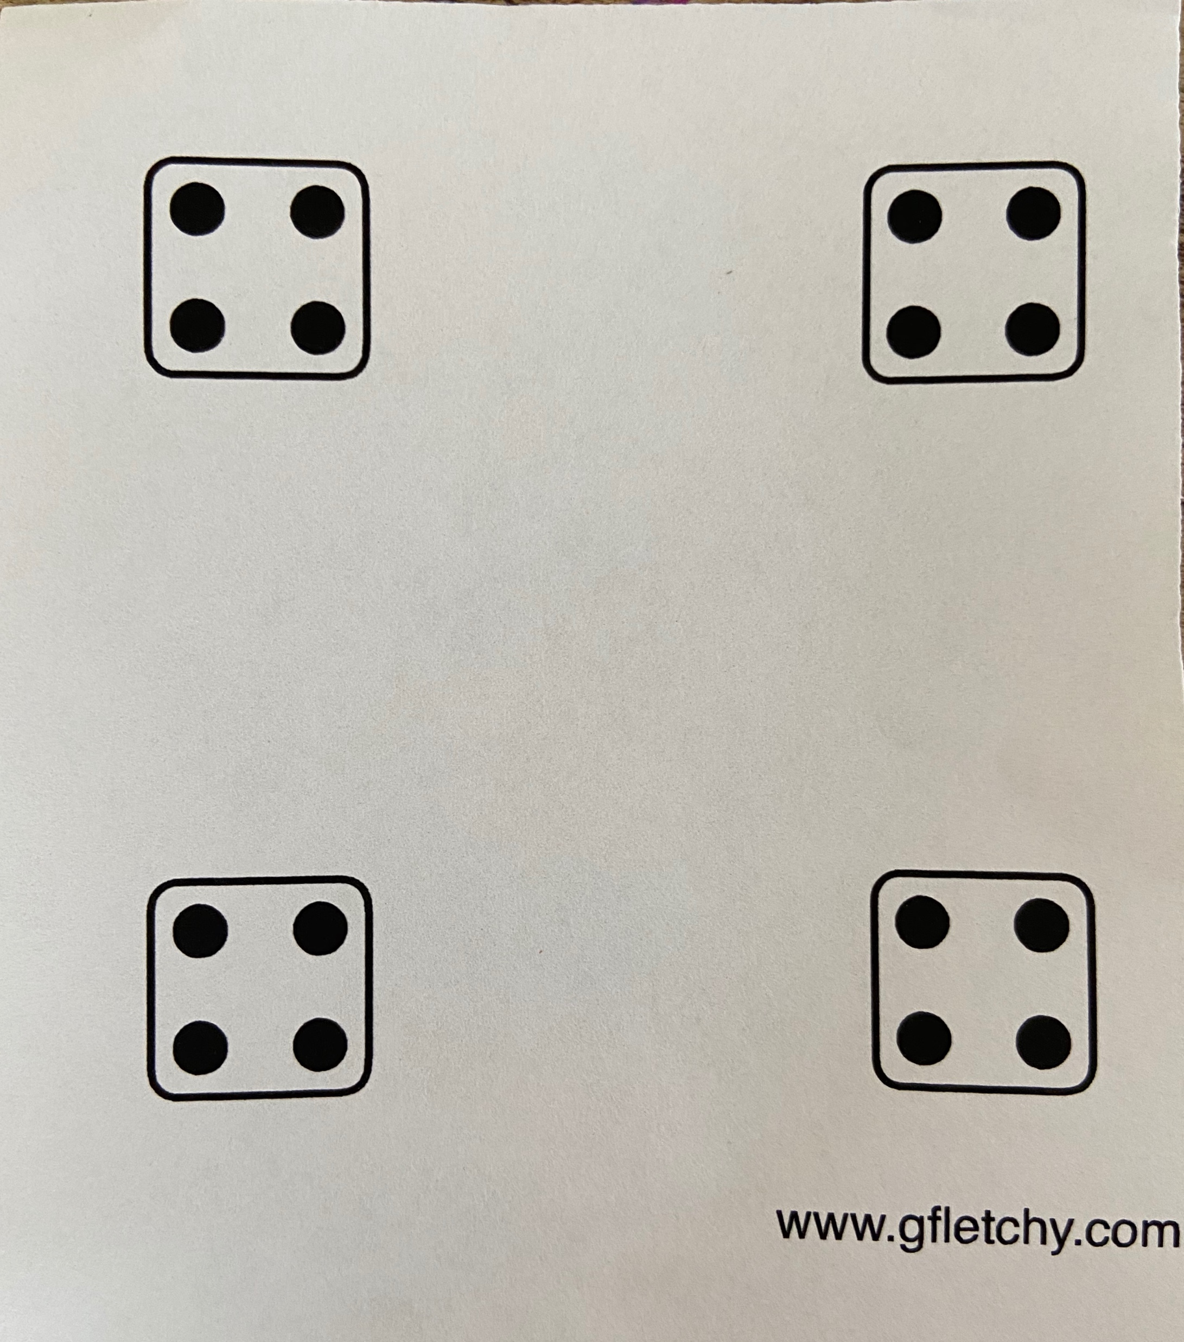

Slide 13
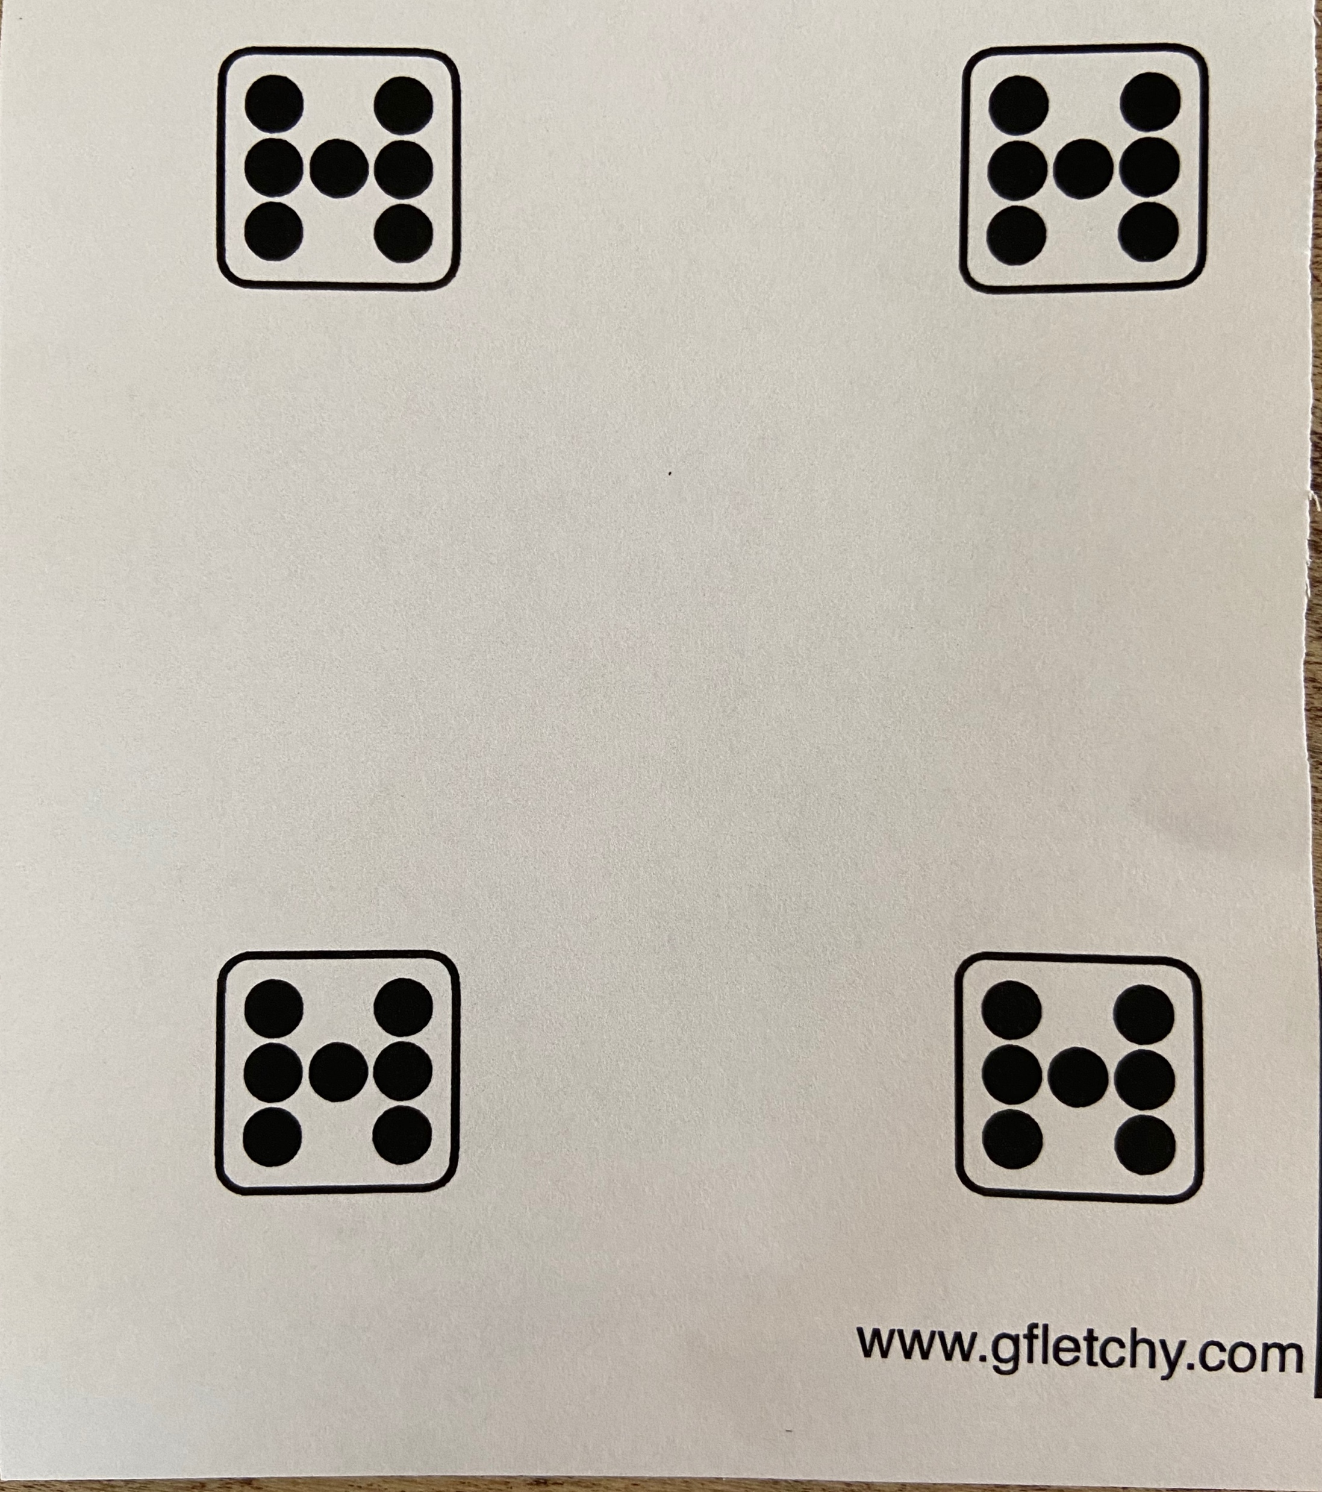

Slide 15
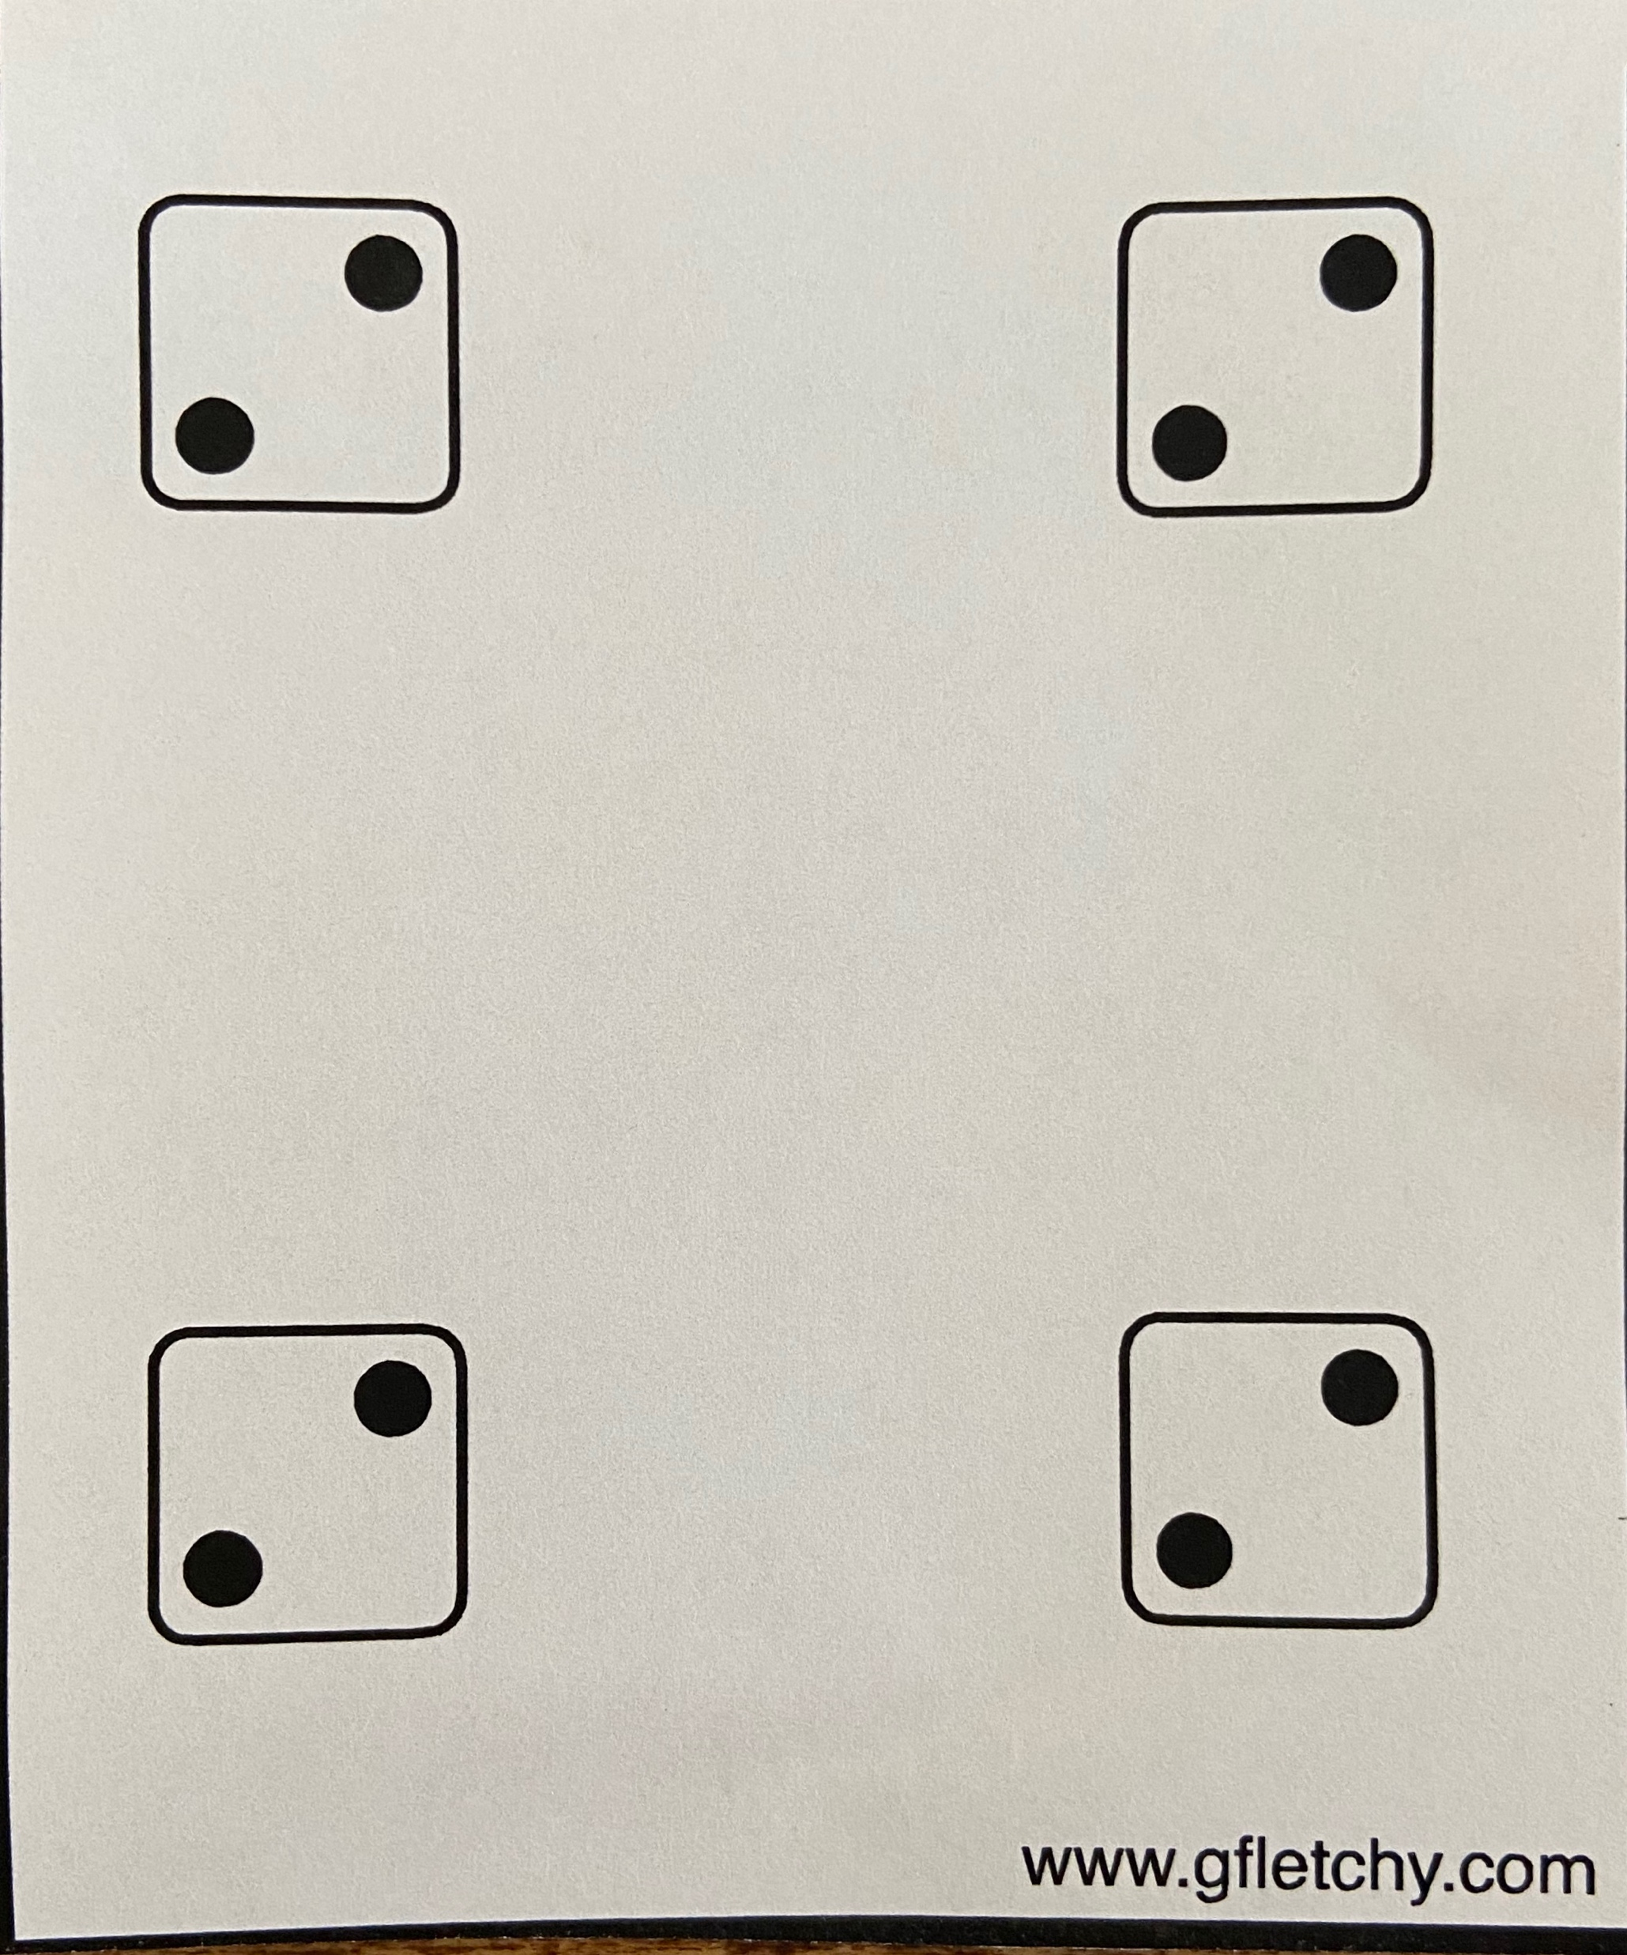

Slide 17
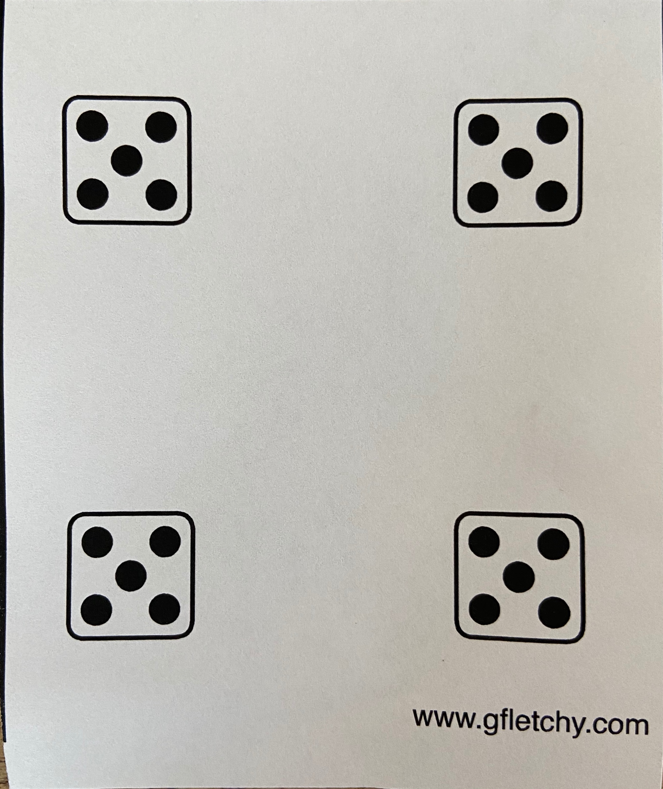

Slide 19


